Slide 1
Inference in FOL [AIMA Ch. 9]
Reducing first-order inference to propositional inference
Unification
Generalized Modus Ponens
Forward and backward chaining
Logic programming
Resolution

Slide 2
A brief history of reasoning
450b.c.
322b.c.
1565
Stoics Aristotle Cardano
propositional logic, inference (maybe) “syllogisms” (inference rules), quantifiers probability theory (propositional logic+ uncertainty)
propositional logic (again) first-order logic
proof by truth tables
∃ complete algorithm for FOL
complete algorithm for FOL (reduce to propositional)
¬∃ complete algorithm for arithmetic
“practical” algorithm for propositional logic
“practical” algorithm for FOL—resolution
1847
1879
1922
1930
1930
Boole Frege
Wittgenstein Gödel Herbrand
1931
1960
Gödel Davis/Putnam
1965
Robinson

Slide 3
Universal instantiation (UI)
Every instantiation of a universally quantified sentence is entailed by it:
∀v α
SUBST({v/g}, α)
for any variable v and ground term g
E.g., ∀x King(x) ∧ Greedy(x) ⇒ Evil(x) yields King(John) ∧ Greedy(John) ⇒ Evil(John) King(Richard) ∧ Greedy(Richard) ⇒ Evil(Richard)
King(Father(John)) ∧ Greedy(Father(John)) ⇒ Evil(Father(John))
…

Slide 4
Existential instantiation (EI)
For any sentence α, variable v, and constant symbol k that does not appear elsewhere in the knowledge base:
∃v α
SUBST({v/k}, α)
E.g., ∃x Crown(x) ∧ OnHead(x, John)
Crown(C1) ∧ OnHead(C1, John)
yields
provided C1 is a new constant symbol, called a Skolem constant
Another example: from ∃x d(x^{y})/dy=x^{y}
d(e^{y})/dy=e^{y}
provided e is a new constant symbol
we obtain

Slide 5
Existential instantition contd.
UI can be applied several times to add new sentences; the new KB is logically equivalent to the old
EI can be applied once to replace the existential sentence; the new KB is not equivalent to the old, but is satisfiable iff the old KB was satisfiable

Slide 6
Reduction to propositional inference
Suppose the KB contains just the following:
∀x King(x) ∧ Greedy(x) ⇒ Evil(x)
King(John) Greedy(John) Brother(Richard, John)
Instantiating the universal sentence in all possible ways, we have
King(John) ∧ Greedy(John) ⇒ Evil(John)
King(Richard) ∧ Greedy(Richard) ⇒ Evil(Richard) King(John)
Greedy(John) Brother(Richard, John)
The new KB is propositionalized: proposition symbols are
King(John), Greedy(John), Evil(John),King(Richard) etc.

Slide 7
Reduction contd.
Claim: a ground sentence is entailed by new KB iff entailed by original KB
Claim: every FOL KB can be propositionalized so as to preserve entailment
Idea: propositionalize KB and query, apply resolution, return result
Problem: with function symbols, there are infinitely many ground terms,
e.g., Father(Father(Father(John)))

Slide 8
Reduction contd.
Theorem: Herbrand (1930). If a sentence α is entailed by an FOL KB, it is entailed by a finite subset of the propositional KB
Idea: For n = 0 to ∞ do
create a propositional KB by instantiating with depth-n terms and see if α is entailed by KB
Problem: works if α is entailed, loops if α is not entailed
Theorem: Turing (1936), Church (1936), entailment in FOL is semidecidable

Slide 9
Problems with propositionalization
Propositionalization seems to generate lots of irrelevant sentences.
E.g., from
∀x King(x) ∧ Greedy(x) ⇒ Evil(x) King(John)
∀y Greedy(y) Brother(Richard, John)
it seems obvious that Evil(John), but propositionalization produces lots of facts such as Greedy(Richard) that are irrelevant
With p k-ary predicates and n constants, there are p · n^{k}
instantiations
With function symbols, it gets much much worse!

Slide 10
Unification
We can get the inference immediately if we can find a substitution θ such that King(x) and Greedy(x) match King(John) and Greedy(y)
θ = {x/John, y/John} works
UNIFY(α, β) = θ if αθ = βθ
p
q
θ
Knows(John, x) Knows(John, x) Knows(John, x) Knows(John, x)
Knows(John, Jane) Knows(y,OJ) Knows(y,Mother(y)) Knows(x,OJ)
{x/Jane}
{x/OJ, y/John}
{y/John, x/Mother(John)} fail
Standardizing apart eliminates overlap of variables, e.g., Knows(z₁₇, OJ)

Slide 11
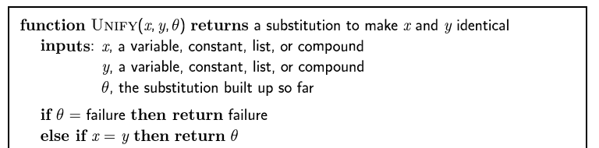
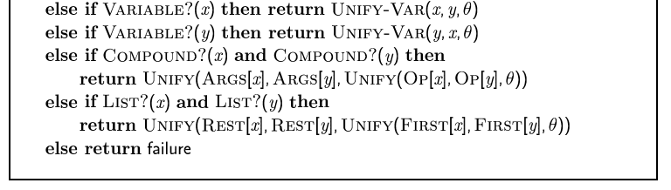
The unification algorithm

Slide 12
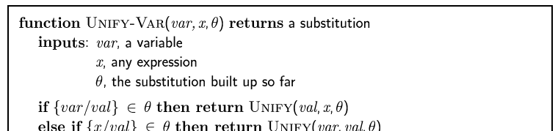

The unification algorithm

Slide 13
Generalized Modus Ponens (GMP)
p₁’, p₂’, … , p_{n}’ , (p₁ ∧ p₂ ∧ … ∧ p_{n} ⇒ q)
qθ
where p_{i}’θ = p_{i}θ for all i
p₁’ is King(John)
p₂’ is Greedy(y)
θ is {x/John, y/John}
q θ is Evil(John)
p₁ is King(x) p₂ is Greedy(x) q is Evil(x)
GMP used with KB of definite clauses (exactly one positive literal)
All variables assumed universally quantified

Slide 14
Soundness of GMP
Need to show that
p₁’, p₂’, … , p_{n}’ , (p₁ ∧ p₂ ∧ … ∧ p_{n} ⇒ q) ╞ qθ
provided that p_{i}’θ = p_{i}θ for all i
Lemma: For any definite clause p, we have p╞ pθ by UI
1. (p₁ ∧ p₂ ∧ … ∧ p_{n} ⇒ q) ╞ (p₁ ∧ p₂ ∧ … ∧ p_{n} ⇒ q)θ = (p₁θ ∧ p₂θ
∧ … ∧ p_{n}θ ⇒ q θ)
2. p₁’, p₂’, … , p_{n}’ ╞ p₁’ ∧ p₂’ ∧ … ∧ p_{n}’ ╞ p₁’θ ∧ p₂’θ ∧ … ∧ p_{n}’θ
3. From 1 and 2, q follows by ordinary Modus Ponens

Slide 15
Example knowledge base
The law says that it is a crime for an American to sell weapons to hostile nations. The country Nono, an enemy of America, has some missiles, and all of its missiles were sold to it by Colonel West, who is American.
Prove that Col. West is a criminal

Slide 16
Example knowledge base contd.
… it is a crime for an American to sell weapons to hostile nations:
American(x) ∧ Weapon(y) ∧ Sells(x,y,z) ∧ Hostile(z) ⇒ Criminal(x)
Owns(Nono,M) and Missile(M)
… all of its missiles were sold to it by Colonol West
∀x Missile(x) ∧ Owns(Nono,x) ⇒ Sells(West,x,Nono)
Missiles are weapons:
Missile(x) ⇒ Weapon(x)
An enemy of America counts as “hostile”:
Enemy(x,America) ⇒ Hostile(x)
West, who is American …
American(west)
The country Non, an enemy of America
Enemy(Nono,America)
Nono … has some missiles, i.e.,
∃x Owns(Nono,x) ∧ Missile(x):

Slide 17
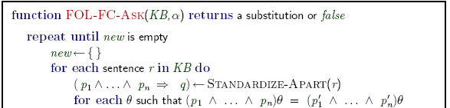
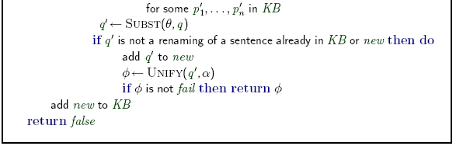
Forward chaining algorithm

Slide 18

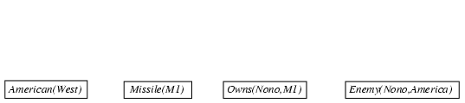
Forward chaining proof

Slide 19
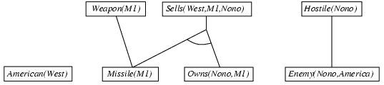
Forward chaining proof

Slide 20


Forward chaining proof

Slide 21
Properties of forward chaining
Sound and complete for first-order definite clauses (proof similar to propositional proof)
Datalog = first-order definite clauses + no functions (e.g., crime KB)
FC terminates for Datalog in poly iterations: at most p · n^{k} literals
May not terminate in general if α is not entailed
This is unavoidable: entailment with definite clauses is semidecidable

Slide 22
Efficiency of forward chaining
Simple observation: no need to match a rule on iteration k if a premise wasn't added on iteration k-1
⇒ match each rule whose premise contains a newly added literal
Matching itself can be expensive
Database indexing allows O(1) retrieval of known facts e.g., query Missile(x) retrieves Missile(M1)
Matching conjunctive premises against known facts is NP-hard
Forward chaining is widely used in deductive databases

Slide 23
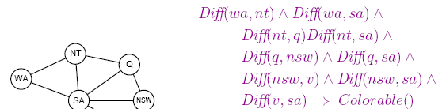

Hard matching example
Colorable() is inferred iff the CSP has a solution
CSPs include 3SAT as a special case, hence matching is NP-hard

Slide 24
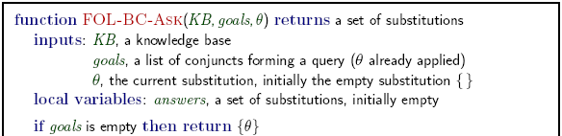
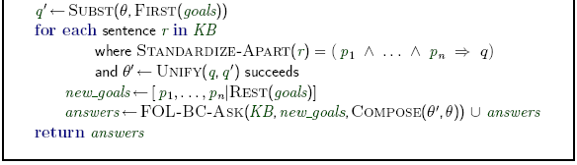
Backward chaining algorithm

Slide 25
Backward chaining example

Slide 26
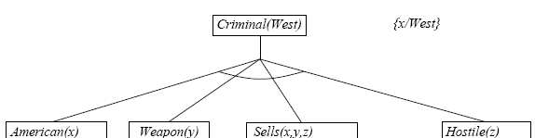
Backward chaining example

Slide 27
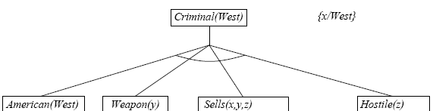
Backward chaining example

Slide 28
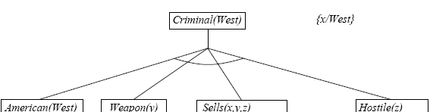
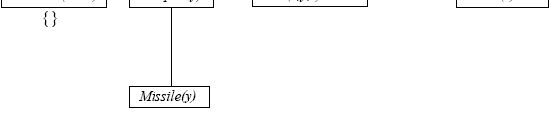
Backward chaining example

Slide 29
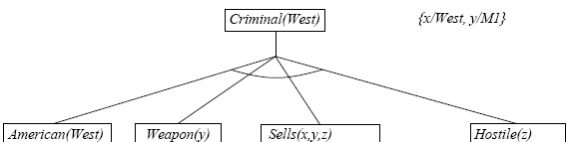
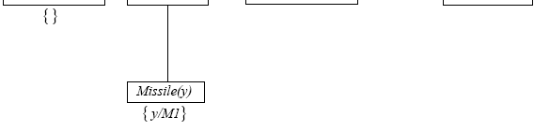
Backward chaining example

Slide 30
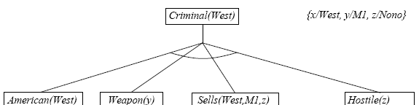
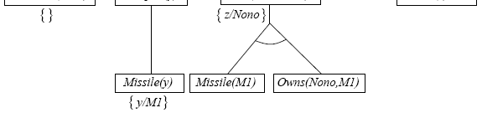
Backward chaining example

Slide 31
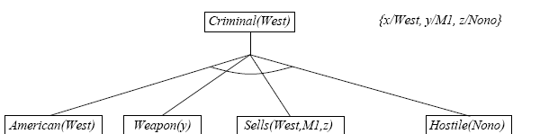
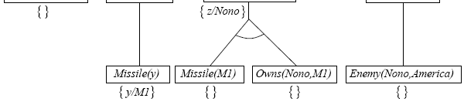
Backward chaining example

Slide 32
Properties of backward chaining
Depth-first recursive proof search: space is linear in size of proof
Incomplete due to infinite loops
⇒ fix by checking current goal against every goal on stack
Inefficient due to repeated subgoals (both success and failure)
⇒ fix using caching of previous results (extra space!)
Widely used (without improvements!) for logic programming

Slide 33
Logic programming
Sound bite: computation as inference on logical KBs
Logic programming
Identify problem
Assemble information
Tea break
Encode information in KB
Encode problem as facts
Ask queries
Find false facts
Ordinary programming Identify problem Assemble information Figure out solution Program solution Encode problem as data Apply program to data Debug procedural errors
Should be easier to debug Capital(NewYork,US) than x := x + 2!

Slide 34
Prolog systems
Basis: backward chaining with Horn clauses + bells & whistles Widely used in Europe, Japan (basis of 5th Generation project) Compilation techniques ⇒ approaching a billion LIPS
Program = set of clauses = head :- literal₁, … literal_{n}.
criminal(X) :- american(X), weapon(Y), sells(X,Y,Z), hostile(Z).
Efficient unification by open coding
Efficient retrieval of matching clauses by direct linking
Depth-first, left-to-right backward chaining
Built-in predicates for arithmetic etc., e.g., X is Y*Z+3
Closed-world assumption (“negation as failure”) e.g., given alive(X) :- not dead(X). alive(joe) succeeds if dead(joe) fails

Slide 35
Prolog examples
Depth-first search from a start state X:
No need to loop over S: successor succeeds for each Appending two lists to produce a third:
append([],Y,Y).
append([X|L],Y,[X|Z]) :- append(L,Y,Z). query: append(A,B,[1,2]) ?
dfs(X) | :- | goal(X).
dfs(X) | :- | successor(X,S),dfs(S).
answers: | A=[] | B=[1,2]
 | A=[1] | B=[2]
 | A=[1,2] | B=[]

Slide 36
Resolution: brief summary
Full first-order version:
l₁ ∨ … ∨ l_{k}, m₁ ∨ … ∨ m_{n}
(l₁ ∨ … l_{i-1} ∨ l_{i+1} ∨ … ∨ l_{k} ∨ m₁ ∨ … ∨ m_{j-1} ∨ m_{j+1} ∨ … ∨ m_{n})θ
where UNIFY(l_{i}, ¬m_{j})=θ.
For example,
¬Rich(x) ∨ Unhappy(x) Rich(Ken)
Unhappy(Ken)
with θ = {x/Ken}
Apply resolution steps to CNF(KB ∧ ¬α); complete for FOL

Slide 37
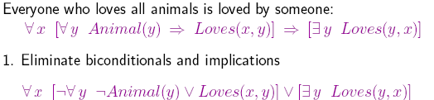
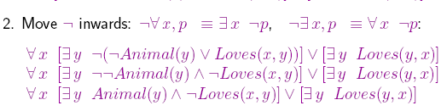
Conversion to CNF

Slide 38
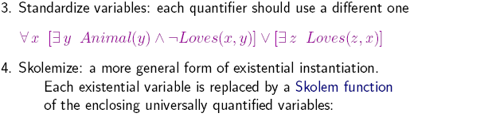
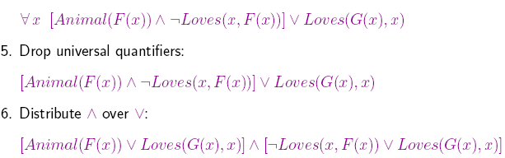
Conversion to CNF contd.

Slide 39
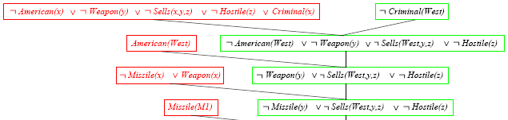
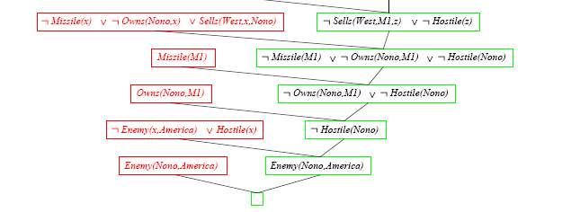
Resolution proof: definite clauses
¬

